Slide 1
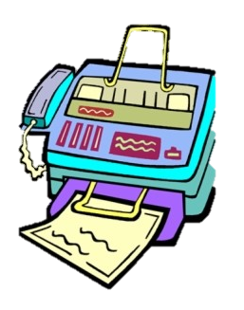
The Fax and the Furious…
The Prescription for Modern Healthcare Data Exchange
Presented by: Raae Wolfram

Slide 2

Agenda
What to look out for…
>Whoami
Background
Legacy of Fax Machines
Security Pitfalls of Fax Machines
Barriers to Care
Digital Transformation
Electronic Health Records (EHRs)
Secure Messaging & Advent of Telemedicine
The HIE Highway
FHIR Up Innovation
From Fax to Future
Conclusion
Shifting Gears from Analog to Digital

Slide 3




>WhoamI
Technology Professional, >15 years
Sr. Product Manager @ Microsoft
New Yorker / Nuyorican
Mom
Star Trek Fan
Had brain surgery in 2016; radiation in 2022
I don’t drive ¯\_(ツ)_/¯
p 3

Slide 4
Why We’re Shifting Lanes
Getting under the hood, to understand our mission…

Slide 5
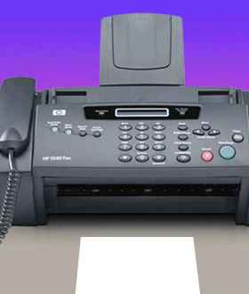
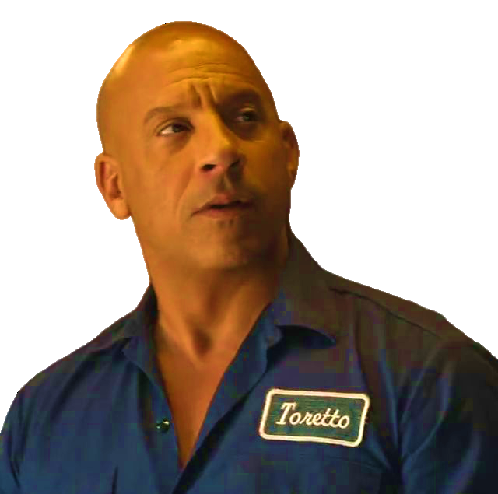
Wtf is a Fax and why tf does it matter
Unpacking the Fax Phenomenon
The genesis of rapid data exchange; still a critical tool in healthcare operations
Why are we at a crossroads?
Antiquated technology and suboptimal medical care
What’s our north star?
A secure healthcare ecosystem, ensuring patient confidentiality and care delivery
Notes:
For decades, Fax machines have been the quarter-mile kings of data exchange, speeding through healthcare’s communication lanes. In the 1960s, fax machines revolutionized healthcare communication, becoming the standard for data exchange. They symbolized technological advancement, enabling swift sharing of medical documents and information.
However, the continued use of fax machines now poses significant risks – both in patient care and in terms of security. These devices, once heralded for their efficiency, have become potential gateways for data breaches and security threats in our healthcare systems.
I want to shed light on the importance of moving beyond outdated fax technology. Our focus is on understanding the cybersecurity imperatives that drive the need for digital transformation in healthcare communication. The aim of this presentation is to champion a future where security and efficiency drive patient care to the finish line.

Slide 6




Historical Acceleration
The first fax machine, or facsimile machine, was invented in 1843 by Alexander Bain
Commercial Success in1960s: By 1970s, the fax entered healthcare, marking a new era in medical communication
Fax was the Lifeline of Healthcare Communication, for Quick, Reliable Patient Information Sharing
Notes:
The fax was created in 1840s by Alexander Bain, known as the electric printing telegraph. This innovation laid the groundwork for what would become a pivotal tool in business and healthcare communications.
A fax machine works by converting the contents of a physical document into a series of electronic signals that can be transmitted over a phone line to another fax machine, which then decodes these signals back into an image, printing out a replica of the original document.
The advent of fax machines in healthcare during the 1970s marked a significant evolution in the way medical information was shared and managed. There was also growing attention to patient privacy and data security. The fax machine, being a direct and relatively secure method of communication, helped healthcare providers comply with the emerging regulations regarding patient information privacy.
This period saw the transition from manual, paper-based systems to more immediate electronic communication, fundamentally changing the landscape of healthcare administration and patient care.
The adoption of fax machines in healthcare during the 1970s laid the groundwork for the digital communication networks that would later become integral to the industry. It represented a significant step forward in the ability of healthcare providers to communicate quickly and effectively, thus improving the overall standard of patient care.

Slide 7

Endurance Race
Understanding Fax's Tenacity in Healthcare
Established as a standard due to its widespread availability and simplicity
Continues as a legacy system due to entrenched habits and resistance to change
Fax machines are deemed compliant with HIPAA and other privacy laws
Classic Cruise Control

Slide 8
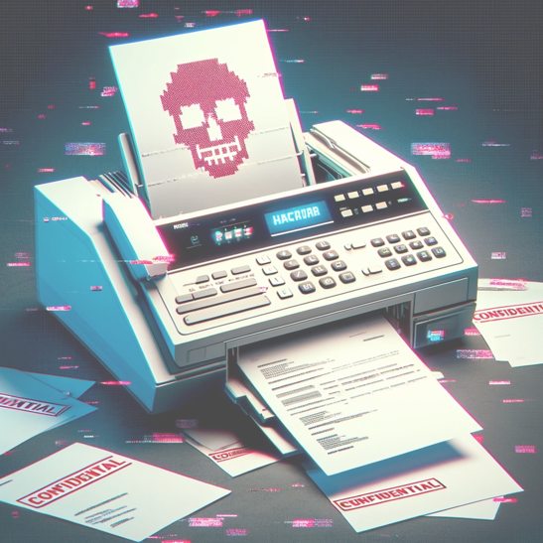

High-Speed Hazards: Pitfalls of Faxes in Healthcare
Security Spinout: Losing Control in the Fast Lane
Speed Traps and Security Gaps
Lack of encryption and secure authentication
Risks of physical document theft in communal areas
Misdialed numbers and machine errors can cause serious information mishaps
Delays in fax communication can lead to slower patient care and treatment
Dependence on fax machines may exclude or inconvenience patients without easy access to fax technology
Notes:
Lack of Modern Security Measures:
Fax technology does not inherently support modern encryption methods.
Absence of secure authentication leaves faxed documents vulnerable to interception.
Physical Security Risks:
Documents sent via fax can be left unattended in shared spaces, risking unauthorized access.
Sensitive information is potentially exposed to any passerby, increasing the chance of theft or misuse.
while fax machines have been steady participants in the healthcare communication race, the risks they present—from security breaches to operational inefficiencies and impacts on patient care—highlight the need for a shift towards more secure, efficient, and accessible communication methods in our healthcare systems

Slide 9



Roadblocks to Healthcare
Fax in the Rearview
Outrunning the Outdated
Equipment and Operational Constraints
Faxes require specific hardware that may not be readily available to all patients or providers, particularly in remote or underserved areas
Challenge for patients without fax access
Delays in obtaining necessary medical information can affect treatment timelines
?!
Fax technology not immune to Common Vulnerabilities and Exposures (CVEs)
Discovered by Check Point researchers, Faxploit exploits weaknesses in the communication protocol used by fax machines
Through compromised phone lines, attackers can send maliciously crafted images which, when processed by a fax machine, allow them to infiltrate connected networks
Notes:
Understanding and addressing these vulnerabilities is not just about technology upgrades but about protecting the very core of patient trust and data security in healthcare. The shift from fax to digital is not merely beneficial—it's essential for securing healthcare communications against modern cyber threats

Slide 10
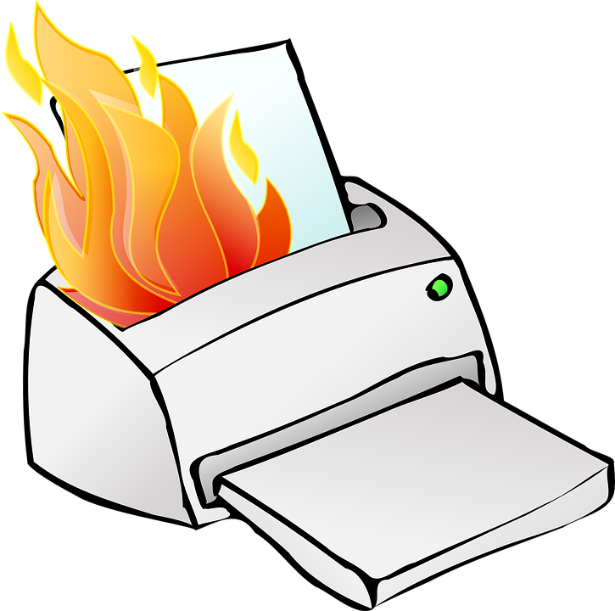

Risky rides, Safe Shifts
Digital Overdrive & Next Gear Necessity – Shifting Up to Safer Healthcare Communication Lanes

Slide 11
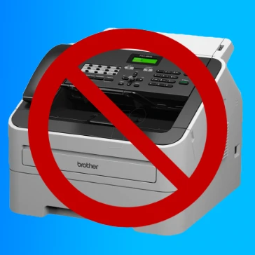

The Need for Digital Overhaul
Digital platforms offer robust security protocols, including multi-factor authentication and end-to-end encryption
Automated digital workflows minimize human error and enhance data integrity and traceability
Facilitate real-time data exchange, equipped with advanced threat detection and response mechanisms
Support scalable security measures, adapting to evolving cyber threats and regulatory requirements
p 11
BSides Puerto Rico - Raae Wolfram

Slide 12

A Turbocharged Upgrade for Healthcare Data Protection
Transitioning from traditional faxing to secure electronic methods is crucial for modernizing healthcare data exchange:
Secure messaging platforms offer encrypted communication channels for sharing sensitive patient information
Integrating Electronic Health Records (EHR) with secure communication systems streamlines data exchange and enhances interoperability
Health Information Exchange (HIE) Messaging platforms facilitate secure and standardized exchange of patient health information among healthcare entities
Fueling Efficiency and Security

Slide 13


Thank You
Raae Wolfram
digitalraae[at]gmail[dot]com

